Slide 1
CPSY 1950
Deep Learning in Brains, Minds & Machines
Scaling, transfer & emergence
What happens when you scale up the three levers?

Slide 2
This week
W 1–2
W 3
W 4
W 5
What is NeuroAI?
Three levers:
architecture · objective · data
Scaling:
transfer learning · ICL · emergence · multi-modality
Prediction vs. understanding
→
→
→
Today's reading: Firestone (2020). Performance vs. competence in human–machine comparisons. PNAS

Slide 3
Last week: the three levers
🏗️ Architecture
🎯 Training Objective
📊 Data / Experience
CNNs → Transformers
One model family now dominates
vision, language, audio, etc
Supervised → self-supervised
Next-token pred, masked, contrastive, etc
No labels needed at scale
ImageNet (1.2M images)
→ LAION-5B (5.85B pairs)
1000× growth in a decade
This week's question: When you scale data + models (and compute)
what new capabilities appear?
and should we believe them?

Slide 4
The “pretraining-then-transfer” revolution
Old Approach
New Approach
Train from scratch on labeled data for one specific task
Pretrain on massive data with a generative pretraining objective before finetuning/adapting/transfering to specific tasks
→
Why this matters:
Models learn richer, more flexible representations before “specializing”
You invest once in a "foundation," then reuse it everywhere by adapting to specific tasks (finetuning)
e.g., BERT model family: BioBERT (biomedical literature), ClinicalBERT (clinical notes), SciBERT (scientific papers), LegalBERT (legal documents), etc

Slide 5
How pretraining works
Autoregressive (GPT family)
Masked prediction (BERT, MAE)
Contrastive (CLIP, SimCLR)
The
cat
sat
on
???
The
MASK
sat
MASK
the
🐱 image
"a cat"
→ Predict the next token
→ Fill in the blanks
✓ pull together
Models: GPT-2, GPT-3, GPT-4, LLaMA, DeepSeek, Claude, etc
Implicitly learns grammar,
facts, reasoning, code...
Models: BERT, RoBERTa, MAE
Forces bidirectional context.
Excellent for understanding
tasks (classification, NER).
Models: CLIP, ALIGN, SigLIP, SimCLR, DINO
Learn shared embedding space; key for VLMs
(LLaVA uses CLIP encoder).
Same objectives as W3 — but at 100–1000× the scale
GPT-2 vs. GPT-3 had 1.5B vs. 175B
Same recipe but qualitatively different results!
Notes:
The objectives haven't changed—just the scale.

Slide 6
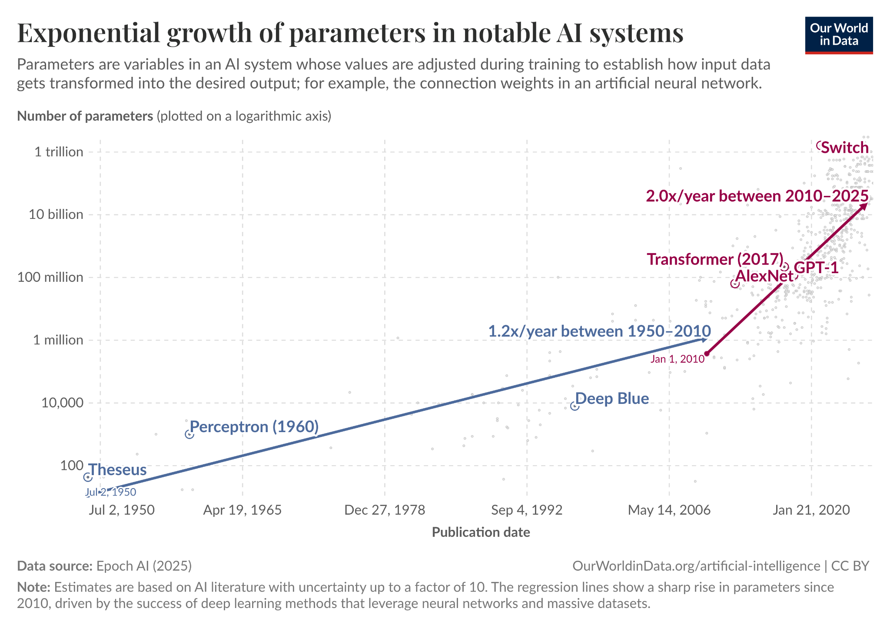
Scaling drives the development of modern deep nets
Notes:
Since then, the development of modern deep networks has been driven primarily by engineering considerations—maximizing classification accuracy and scaling to larger datasets and architectures—rather than by biological constraints.
This figure from Epoch AI illustrates the dramatic scale of this shift: training compute has grown exponentially, with language models increasing at roughly 6× per year and vision models at 4× per year. From AlexNet in 2012 to today's frontier models like GPT-4 and Gemini Ultra, we've seen an increase of over ten orders of magnitude in training compute. This is scaling on a scale that biology simply cannot match.

Slide 7
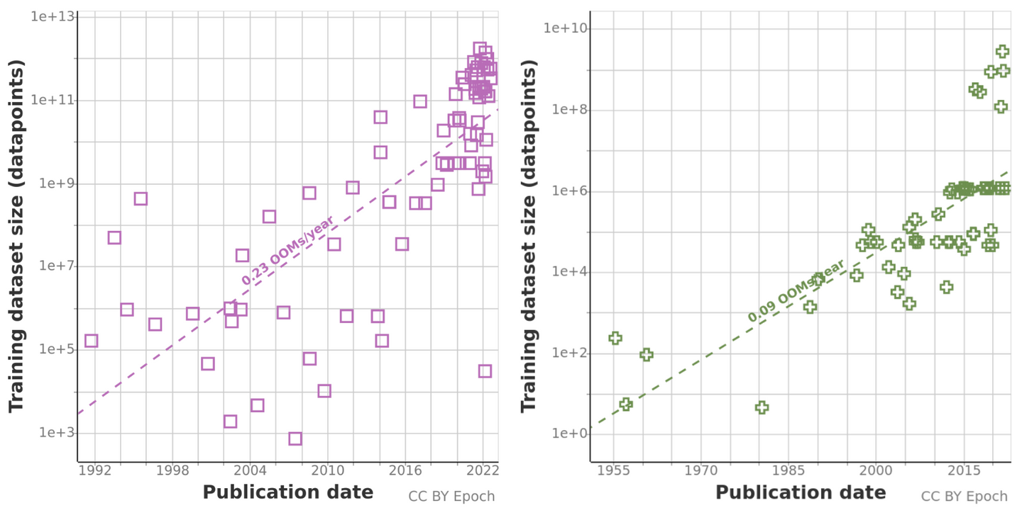
Scaling drives the development of modern deep nets
Source: https://epoch.ai/publications/trends-in-training-dataset-sizes
Notes:
This figure from Epoch AI illustrates the dramatic scale of this shift: training compute has grown exponentially, with language models increasing at roughly 6× per year and vision models at 4× per year. From AlexNet in 2012 to today's frontier models like GPT-4 and Gemini Ultra, we've seen an increase of over ten orders of magnitude in training compute. This is scaling on a scale that biology simply cannot match.

Slide 8
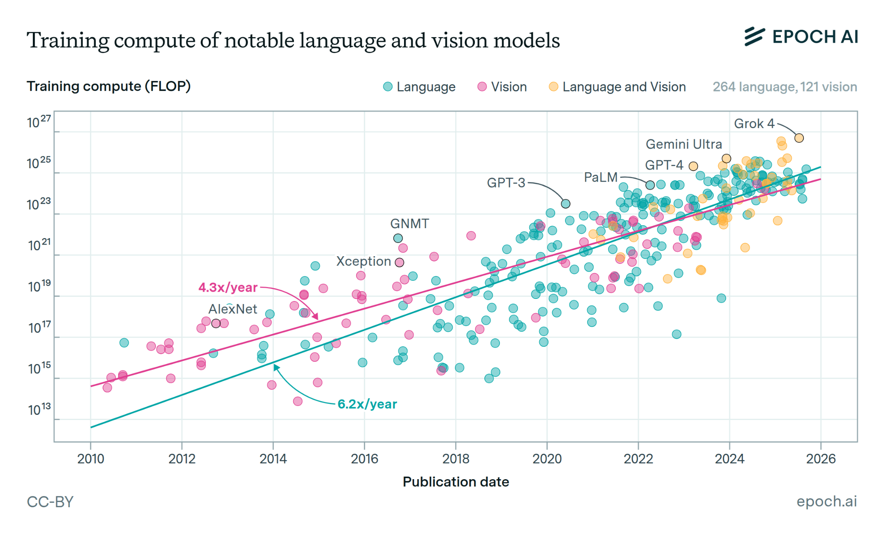
Scaling drives the development of modern deep nets
Source: https://epoch.ai/data-insights/compute-trend-language-vs-vision
Notes:
Since then, the development of modern deep networks has been driven primarily by engineering considerations—maximizing classification accuracy and scaling to larger datasets and architectures—rather than by biological constraints.
This figure from Epoch AI illustrates the dramatic scale of this shift: training compute has grown exponentially, with language models increasing at roughly 6× per year and vision models at 4× per year. From AlexNet in 2012 to today's frontier models like GPT-4 and Gemini Ultra, we've seen an increase of over ten orders of magnitude in training compute. This is scaling on a scale that biology simply cannot match.

Slide 9
The model landscape
Every 1–2 years, a new approach dominates
Bigger models, better data, smarter training
Thursday's papers span this entire timeline
GPT-2
Chinchilla
LLaMA
DeepSeek-R1
OpenAI
1.5B
DeepMind
70B
Meta
7–65B
DeepSeek
671B
2019
2022
2023
2025
GPT-3
ChatGPT
GPT-4
OpenAI
175B
OpenAI
RLHF
OpenAI
MoE
2020
2022
2023
Notes:
GPT-3 to ChatGPT was just adding RLHF (same base model). LLaMA made open-source competitive. DeepSeek-R1 showed RL alone can induce reasoning.
Mention Claude, Gemini, Mistral as other key players

Slide 10
Fine-tuning & alignment
How raw language models become useful assistant

Slide 11
The foundation model pipeline
Every modern AI system follows the same three-stage recipe:
1
2
3
PRETRAIN
FINETUNE/TRANSFER
DEPLOY
Learn general representations from massive unlabeled data
→
Fine-tune for safety, helpfulness, or specific tasks
→
Use via prompting and/or few-shot examples
GPT-3 trained on 300B tokens from books, web, Wikipedia, etc
InstructGPT used RLHF,
LoRA adapts with 0.1% of params
ChatGPT, Claude, Gemini
all follow this pipeline
Foundation models: pretrain on huge datasets (expensive) then adapt to tasks (cheap).
see Bommasani et al arXiv 2021

Slide 12
The problem with raw pretrained models
A model trained to "predict the next word" is powerful but uncontrolled:
❌ Raw GPT-3 (before alignment)
✓ After RLHF (InstructGPT/ChatGPT)
User: Write a poem about spring. GPT-3: Write a poem about spring.
Write a poem about summer.
Write a poem about fall.
Write a poem about...
User: Write a poem about spring. InstructGPT: Beneath the thawing earth,
new tendrils push toward light—
spring hums quietly.
Completes text, doesn't follow instructions
Understands intent, generates helpful response
Gap between "predicts text" and "follows instructions" is called the alignment problem
InstructGPT/ChatGPT solved this with Reinforcement Learning from Human Feedback (RLHF)
Notes:
Raw GPT-3 is a text-completion engine—it continues patterns, not intentions. The poem example shows the difference clearly. Note that InstructGPT (1.3B parameters with RLHF) was preferred by humans over raw GPT-3 (175B) — alignment matters more than scale.

Slide 13
RLHF: teaching a model to be helpful
Three steps transform a text predictor into an assistant:
1
Supervised fine-tuning (SFT)
Show model examples of ideal responses written by hum
It learns the format of helpful conversation
↓
2
Train a reward model
Generate multiple responses from the SFT model
Hum compare pairs of model outputs and pick the better one (much easier than producing outputs)
A separate (reward) model learns to predict these prefs
↓
3
RL optimization (PPO)
Language model generates responses
A reward model scores them
the LM is updated to get higher scores
Ouyang et al NeurIPS 2022

Slide 14
LoRA: efficient adaptation
Fine-tuning all 175 billion parameters of GPT-3 is expensive!
Can we adapt a model by changing just a tiny fraction?
W
W
W
(frozen)
A
Full fine-tuning
LoRA (low-rank adaptation)
×
B
+
vs.
Only train A and B
(small matrices)
Update all
175B parameters
100% of weights
~90% of full fine-tuning quality at ~0.1% of weights
The rank of A×B is small (typically 4–16) hence 'low-rank.'
Hu et al ICLR 2022

Slide 15
Why does low-rank adaptation work?
Key insight: the changes needed for a new task live in a low-dimensional subspace
Master photographer switching from weddings to nature doesn't relearn composition, lighting, exposure… the adjustment is low-dim even though the underlying skill is vast
Counterintuitively, the bigger the model, the smaller the subspace needed to adapt
Deep question: what does pretraining actually learn? A general-purpose representation space where tasks correspond to specific directions — and adapting means finding those directions

Slide 16
What scale unlocks (in autoregressive language models)
In-context learning, reasoning, and surprising new capabilities

Slide 17
GPT-3: In-context learning
With enough scale, models can learn new tasks from examples in the prompt — no training required!
Zero-shot
One-shot
Few-shot
Just instructions
One example + query
Several examples
Translate to French:
The cat sat on the mat
sea otter → loutre de mer
cheese → ???
positive: I love this movie
negative: Terrible acting
positive: Best film ever
??? : Waste of time
↓
↓
↓
Le chat était assis sur le tapis
fromage
negative
This only works above a certain scale
GPT-2 (1.5B) can barely do it. GPT-3 (175B) does it well. Why?
Thursday papers by Min et al. and Russin et al. explore this directly.
Brown et al NeurIPS 2020
Notes:
No gradient updates, no fine-tuning — the model 'learns' the task from the prompt alone. This was the central claim of GPT-3 and is one of the most surprising capabilities of large language models.

Slide 18
Chain-of-thought (CoT)
❌ Without chain-of-thought
✓ With chain-of-thought
Q: A juggler can juggle 16 balls. Half are golf balls, and half of the golf balls are blue. How many blue golf balls? A: 8 ✗ (wrong)
Q: Roger has 5 tennis balls. He buys 2 cans of 3. How many now?He started with 5. He bought 2×3=6. So 5+6=11. The answer is 11.
Q: (same question) A: Let me think step by step.
16 balls total.
Half are golf balls → 8 golf balls.
Half of those are blue → 4.
The answer is
4 ✓
CoT only helps at scale! Small models generate nonsensical reasoning
Above ~100B parameters, the reasoning actually becomes reliable
One of the clearest examples of a capability that appears to scale
Wei et al NeurIPS 2022

Slide 19
Chain-of-thought (CoT)
❌ Without chain-of-thought
✓ With chain-of-thought
Q: A juggler can juggle 16 balls. Half are golf balls, and half of the golf balls are blue. How many blue golf balls? A: 8 ✗ (wrong)
Q: Roger has 5 tennis balls. He buys 2 cans of 3. How many now?He started with 5. He bought 2×3=6. So 5+6=11. The answer is 11.
Q: (same question) A: Let me think step by step.
16 balls total.
Half are golf balls → 8 golf balls.
Half of those are blue → 4.
The answer is
4 ✓
Small wrinkle 😏 Zero-shot CoT (Kojima et al., 2022) showed you can just add "Let's think step by step" to the prompt — no examples needed — and get most of the benefit.
Which makes it even harder to explain: what is the model actually doing?
Wei et al NeurIPS 2022

Slide 20
DeepSeek-R1: reasoning from RL alone
What if you skip human demonstrations entirely and just reward correct answers?
InstructGPT approach
DeepSeek-R1 approach
1. Human demos (SFT)
2. Human comparisons (reward model)
3. RL optimization (PPO)
Humans teach reasoning format first
1. Skip SFT entirely
2. Only reward: "is the answer correct?"
3. RL optimization (GRPO)
No human reasoning demos needed
What emerged without being taught:
Chain-of-thought
Self-verification
Aha moments
Reflection
Step-by-step reasoning
"Let me check my work..."
"Wait, I see a better way"
"My first approach was wrong"
Guo et al Nature 2025
Notes:
Contrast with InstructGPT: both use RL, but DeepSeek skips the human demonstrations entirely. The emergent behaviors (self-verification, aha moments, reflection) were not trained for — they appeared because they helped the model get correct answers. The NeuroAI parallel is real: organisms also develop reasoning strategies through reinforcement, not explicit instruction.

Slide 21
"Emergent" abilities
100%
"Phase transition"
Some abilities appear suddenly above a threshold scale (100+)
Multi-step arithmetic
Word unscrambling
Logical deduction
Analogical reasoning
Code generation
Multi-hop QA
89%
74%
Accuracy
~0%
~0%
~0%
1B
10B
50B
100B
175B
540B
Wei et al TMLR 2022

Slide 22
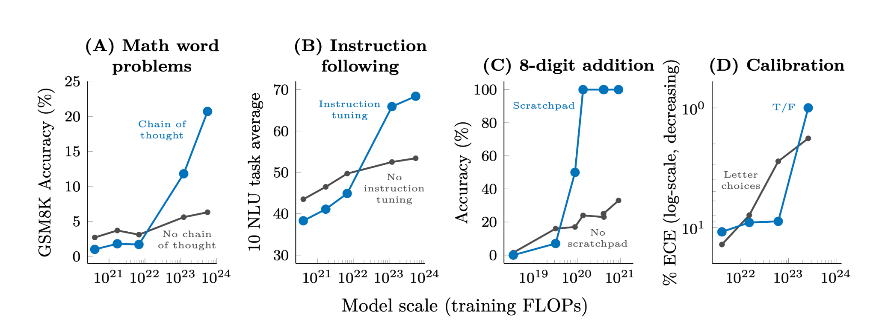
"Emergent" abilities
Wei et al TMLR 2022

Slide 23
Are emergent abilities a mirage?
The way you measure determines what you see…
Imagine grading essays pass/fail if students get 100%
Going to look like they went from "can't write" to "can write" overnight
Grade on a continuous rubric (0–100 points)
Steady improvement all along
The metric creates the illusion...
Schaeffer et al Nature 2024

Slide 24
Scaling laws
Can we predict what bigger models will do?

Slide 25
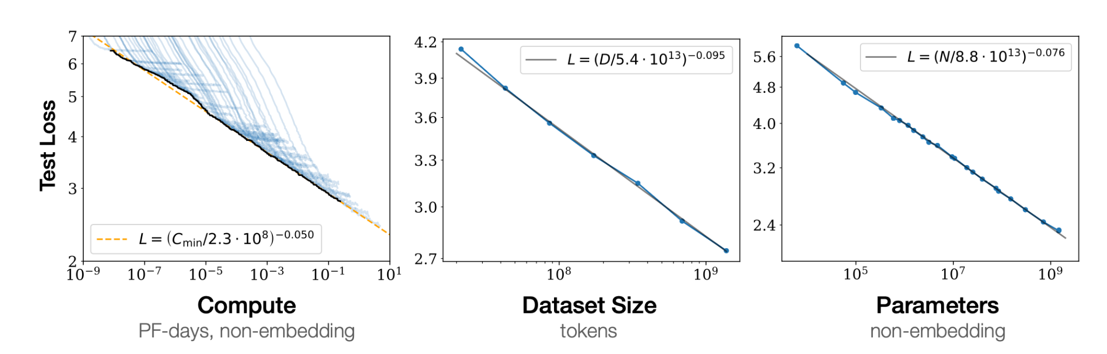
Scaling laws: performance is predictable
Kaplan et al. (2020) discovered that model quality improves as a smooth power law:
Companies (OpenAI, Google, Anthropic) use scaling laws to plan training runs that cost $10M–$100M+
Kaplan et al arXiv 2020
Notes:
Scaling became a deliberate engineering strategy because of this predictability.

Slide 26
Scaling laws: performance is predictable
What this means:
If you know the exponent α, you can predict how good a model will be before you train it
Transformed AI research from guesswork into engineering
Labs now run small experiments, fit the scaling law, and extrapolate to decide if a billion-dollar training run is worth it
Analogy: Like Moore's Law for transistors — a predictable trend that enables long-term planning
But unlike transistors, we don't fully understand WHY it works so well…
Kaplan et al arXiv 2020

Slide 27
Chinchilla: it's not just about model size
The old strategy ("Gopher")
The better strategy ("Chinchilla")
Model:
280B params
🏗️🏗️🏗️
Data:
300B tokens
Model:
70B params
🏗️
Data:
1.4 TRILLION tokens
📚📚📚📚📚
Make the model as big as possible.
Undertrained on limited data.
4× smaller model, 4.5× more data.
Same compute budget. Better results.
LLaMA (2023) followed Chinchilla's recipe — smaller, well-trained models that outperform larger undertrained ones. Today, every lab balances model size against data quantity. More isn't always better — it has to be the right more.
Hoffmann et al NeurIPS 2022

Slide 28
How much compute do we have at Brown?
64 B200 GPUs = 64% of all compute from only 7% of GPU count
GPU Model | Count | vRAM | FP16 TF (per GPU) | Subtotal (PFLOPS)
B200 (DGX) | 64 | 192 GB | 4,500 | 288.0
L40S | 116 | 48 GB | 366 | 42.5
RTX PRO 6000 BW | 88 | 96 GB | ~500 | ~44.0
H100 SXM | 30 | 80 GB | 990 | 29.7
A5000 | 186 | 24 GB | 65 | 12.1
3090 / A5500 / A6000 | 264 | 24–48 GB | 65–78 | ~18.7
Quadro RTX + others | 132 | 12–48 GB | 8–32 | ~5.0
TOTAL | ~880 |  |  | ~450
GPT-2 (1.5B) ≈ 10 PF-days → hours ✓
GPT-3 (175B) ≈ 3,600 PF-days → weeks
Llama 3 (405B) ≈ 250K PF-days → years ✗
We can train up to GPT-3-scale models. Frontier models (Llama 3, GPT-4) require hyperscale clusters with 10,000+ GPUs.
Source: CCV Oscar inventory (Feb 2025). FP16 Tensor TFLOPS. Table generated by Claude.
Notes:
Brown CCV Oscar GPU Compute Capacity This slide gives students a concrete sense of what "compute" means at a university scale vs. industry. INVENTORY HIGHLIGHTS: - ~880 GPUs total across Oscar cluster - ~450 PFLOPS peak FP16 tensor compute - The 64 B200 GPUs (from the $1.34M NIH S10 grant) account for ~64% of all compute despite being ~7% of GPUs - 88 new RTX PRO 6000 Blackwell Max-Q workstation GPUs add another ~44 PFLOPS PF-DAY CONVERSIONS: - 1 PF-day = 10^15 FLOP/s × 86,400 seconds = 8.64 × 10^19 FLOP - At ~450 PFLOPS peak, Brown could theoretically do ~450 PF-days per day - Realistic utilization (30-40%) → ~150 PF-days per actual day

Slide 29
The model landscape
Every 1–2 years, a new approach dominates
Bigger models, better data, smarter training
Thursday's papers span this entire timeline
GPT-2
Chinchilla
LLaMA
DeepSeek-R1
OpenAI
1.5B
DeepMind
70B
Meta
7–65B
DeepSeek
671B
2019
2022
2023
2025
GPT-3
ChatGPT
GPT-4
OpenAI
175B
OpenAI
RLHF
OpenAI
MoE
2020
2022
2023

Slide 30
Vision meets language
Are representations converging across modalities?

Slide 31
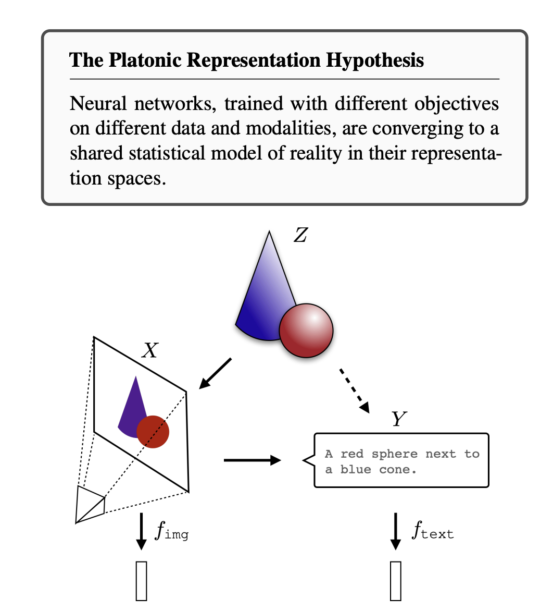
The Platonic representation hypothesis
A bold claim: as models get bigger, their representations are converging — regardless of architecture, objective, or modality.
Huh et al ICML 2024

Slide 32
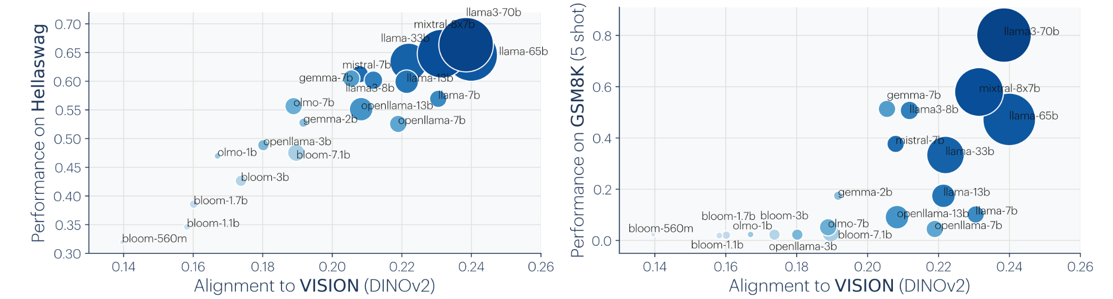
The Platonic representation hypothesis
Huh et al ICML 2024

Slide 33
How LLaVA bridges vision and language
Architecture: connect a pretrained vision encoder to a pretrained language model:
📷 Image
Input
CLIP Vision
Encoder
Linear
Projection
LLM
(Vicuna)
💬 Text
Output
A photo, diagram,
or screenshot
→
Converts image
to 576 visual
tokens (vectors)
→
Maps visual
tokens into the
LLM's space
→
Processes visual
+ text tokens
together
→
"This is a photo
of a sunset
over the ocean"
What gets trained:
Only the projection layer + LLM fine-tuning
CLIP encoder stays frozen
158K visual instruction examples
Liu et al NeurIPS 2023

Slide 34
What can vision-language models actually do?
Visual Q&A
Image reasoning
Chart understanding
Spatial reasoning
"What breed of dog is this?"
"What's unusual
about this image?"
"Summarize the trend
in this graph."
"What's to the left
of the red cup?"
↓
↓
↓
↓
"This appears to be a
Golden Retriever puppy,
about 3 months old."
"The traffic light is
upside down — green is
on top instead of red."
"Revenue grew 20% YoY
from 2020–2023, with
a dip in Q2 2022."
"A blue notebook is
to the left, partially
obscured by a pen."
GPT-4V (OpenAI), Gemini (Google), Claude 3+ (Anthropic), LLaVA (open-source) — all use variations of the same idea: pretrained vision encoder + pretrained LLM + bridging layer.

Slide 35
From CNNs to VLMs — Model Scaling in Vision
Model | Year | Type | Params | Training data | ~PF-days
AlexNet | 2012 | CNN | 60M | 1.2M imgs | ~0.01
ResNet-152 | 2015 | CNN | 60M | 1.2M imgs | ~0.05
ViT-B/16 | 2020 | ViT | 86M | 300M imgs | ~3
ViT-L/16 | 2020 | ViT | 307M | 300M imgs | ~10
DINOv2-g | 2023 | ViT (SSL) | 1.1B | 142M imgs | ~500
CLIP ViT-L/14 | 2021 | Contr. VL | 428M | 400M pairs | ~200
SigLIP-SO | 2023 | Contr. VL | 878M | 4B pairs | ~2,000
LLaVA-1.5 | 2024 | Gen. VLM | 7–13B | 1.2M instruct | ~10 (FT)
PaLI-X | 2023 | Gen. VLM | 55B | ~10B pairs | ~30,000
Qwen2-VL | 2024 | Gen. VLM | 2–72B | undisclosed | ~50,000+
GPT-4o | 2024 | Gen. VLM | ~1.8T (est) | undisclosed | ~10⁶+
The scaling trajectory: 1,000× every ~5 years
Train: ViTs, DINOv2, CLIP-scale
Fine-tune: LLaVA, Qwen2-VL (LoRA on 72B)
= vision-language model
Compute estimates are approximate. FT = fine-tuning only (backbone pretrained elsewhere).
Table generated by Claude.

Slide 36
Do vision and language share concepts?
Do representations actually align across modalities?
≈
~
⟷
Partial convergence
Modulated by usage
Challenges both extremes
Vision and language models share some representational structure — but not all. Alignment is real but incomplete.
Alignment is stronger for:
• High-frequency words
• Low-polysemy concepts
• Low-dispersion embeddings
(Things the model "knows well")
Neither fully platonic
("everything converges")
nor stochastic parrots
("just surface patterns")
— the truth is in between.
Li et al TACL 2024

Slide 37
Critical perspectives
What do these systems actually "understand"?

Slide 38
The understanding debate
Mahowald et al. (2024)
LLMs master language form (grammar, fluency) but may lack functional competence (reasoning, planning, world knowledge). These are dissociable.
Formal vs. functional competence
Bender et al. (2021)
Systems trained only on form cannot learn meaning. Text-only training leaves fundamental gaps. Plus: environmental costs, bias amplification, illusion of understanding.
Stochastic parrots
Mitchell & Krakauer (2023)
Maps both sides: what would it even mean for an LLM to "understand"? Argues we need to operationalize the concept before we can test it.
The debate over understanding
Notes:
Mahowald et al. gives the analytical framework (formal vs. functional). Bender et al. argues the pessimistic case (form alone isn't enough). Mitchell & Krakauer maps the philosophical landscape.

Slide 39
Summary
What seems clear
What's still debated
✓ Scaling improves loss predictably (power laws)
? Are "emergent" abilities real or metric artifacts?
✓ Pretrained representations transfer broadly
? What does ICL actually compute?
✓ In-context learning appears with scale
? Do LLMs "understand" or just pattern-match?
✓ Alignment (RLHF) can matter more than raw size
? Is convergence deep or superficial?
✓ Data/parameter balance matters (Chinchilla)
? Will scaling continue to produce new capabilities?
✓ Reasoning can emerge from pure RL (DeepSeek)
? Is form alone sufficient for meaning?
✓ Vision and language representations partially converge
? What's missing that biology has?

Slide 40
Thursday: lightning talks — 11 papers, 4 themes
Pretraining
& Transfer
ICL &
Reasoning
Vision &
Language
Critical
Perspectives
1. Brown et al. (GPT-3)
2. Ouyang et al. (InstructGPT)
3. Min et al. (random labels)
4. Russin et al. (IWL vs ICL)
5. Wei (chain-of-thought)
6. Guo et al. (DeepSeek)
7. Li et al. (alignment study)
8. Liu et al. (LLaVA)
9. Mahowald et al. (competence)
10. Bender et al. (parrots)
11. Mitchell & Krakauer (debate)

Slide 41
Discussion
If you had to bet: in 10 years, will scaling alone get us to human-level reasoning, or will we need something fundamentally different? Use today's lecture to informs your answer…

